Slide 1
COMP 5120: UG11
Members: James Lee, William Garrison, Mark Shannon

Slide 2
Project Specifications
Online Bookstore System
Build database using MySQL as DBMS
Create web interface that can connect to backend database
Display tables
Enter queries and show results
Do not allow DROP statement

Slide 3
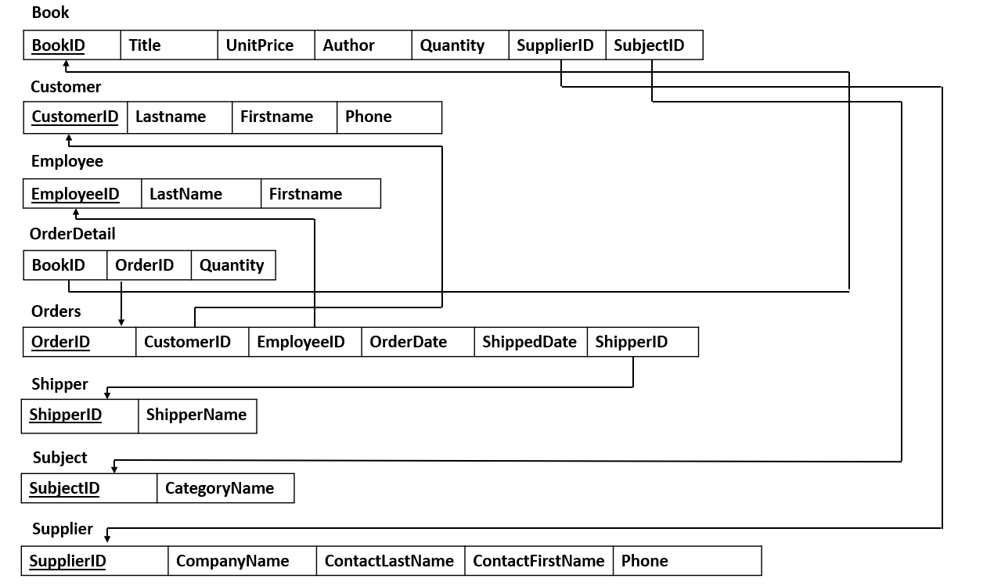
Schema Diagram

Slide 4
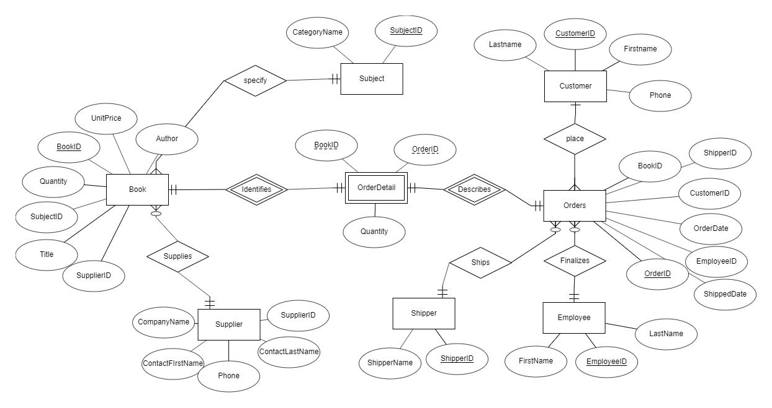
ER Diagram

Slide 5
Create Table Statements

Slide 6
Customer Table
Book Table
CREATE TABLE Book (
BookID INT NOT NULL,
Title VARCHAR(15),
UnitPrice FLOAT,
Author VARCHAR(15),
Quantity INT,
SupplierID INT(11),
SubjectID INT(11),
PRIMARY KEY(BookID),
FOREIGN(SupplierID)
REFERENCES Supplier(SupplierID),
FOREIGN(SubjectID)
REFERENCES Subject(SubjectID)
);
CREATE TABLE Customer (
CustomerID int NOT NULL,
LastName varchar(15),
FirstName varchar(15),
Phone varchar(15),
Primary key(CustomerID)
);

Slide 7
Orders Table
Employee Table
CREATE TABLE Employee (
EmployeeID int NOT NULL,
LastName varchar(15),
FirstName varchar(15),
PRIMARY KEY(EmployeeID)
);
CREATE TABLE Orders (
OrderID int NOT NULL,
CustomerID int NOT NULL,
EmployeeID int NOT NULL,
OrderDate Date,
ShippedDate Date,
ShipperID int,
PRIMARY KEY(OrderID),
FOREIGN KEY(CustomerID)
REFERENCES Customer(CustomerID),
FOREIGN KEY(EmployeeID)
REFERENCES Employee(EmployeeID)
);

Slide 8
Shipper Table
OrderDetail Table
CREATE TABLE OrderDetail(
BookID int NOT NULL,
OrderID int NOT NULL,
Quantity int,
FOREIGN KEY(BookID)
REFERENCES Book(BookID),
FOREIGN KEY(OrderID)
REFERENCES Orders(OrderID)
);
CREATE TABLE Shipper (
ShipperID int NOT NULL,
ShipperName varchar(15),
PRIMARY KEY(ShipperID)
);

Slide 9
Supplier Table
Subject Table
CREATE TABLE Subject (
SubjectID int NOT NULL,
CategoryName varchar(15),
PRIMARY KEY(SubjectID)
);
CREATE TABLE Supplier (
SupplierID int NOT NULL,
CompanyName varchar(15),
ContactLastName varchar(15),
ContactFirstName varchar(15),
Phone varchar(15),
PRIMARY KEY(SupplierID)
);

Slide 10
Website
Created with HTML, Bootstrap 4, and PHP
Website: http://webhome.auburn.edu/~jyl0003/
Example Query: Show the names of all the ordered books and their total quantities. List the result in ascending quantity.
Query: Select b.Title, SUM(od.Quantity) as Total From Book b, OrderDetail od where od.BookID=b.BookID Group By b.Title Order BY Total ASC

Slide 11
DEMONSTRATION

